Slide 1
Head First
Chapter-2: A Trip to Objectville
Upcode Software
Engineer Team
-2023-

Slide 2
CONTENT
What is Object ?
What is a Class?
Difference between class and object ?
Additional data
Source code
Used materials and references

Slide 3
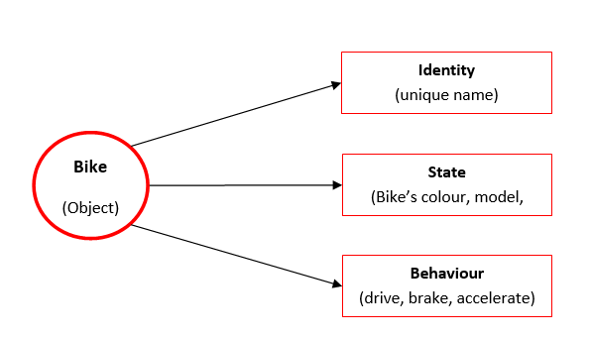
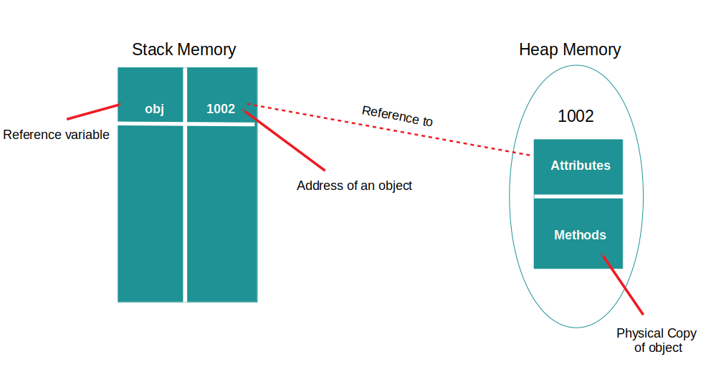
What is Object ?
An object is an instance of a class.
An object has its own identity, behavior, and state.
Objects are created during runtime.
Objects are allocated to memory and space addresses.

Slide 4
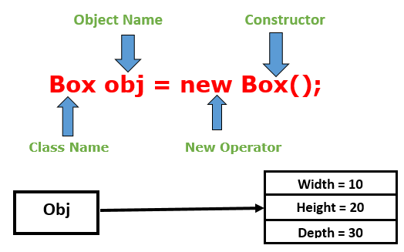
1. What is Object ?
State: represents the data (value) of an object.
Behavior: represents the behavior (functionality) of an object such as deposit, withdraw, etc.
Identity: An object identity is typically implemented via a unique ID. The value of the ID is not visible to the external user. However, it is used internally by the JVM to identify each object uniquely.
An object is created using the new keyword.

Slide 5
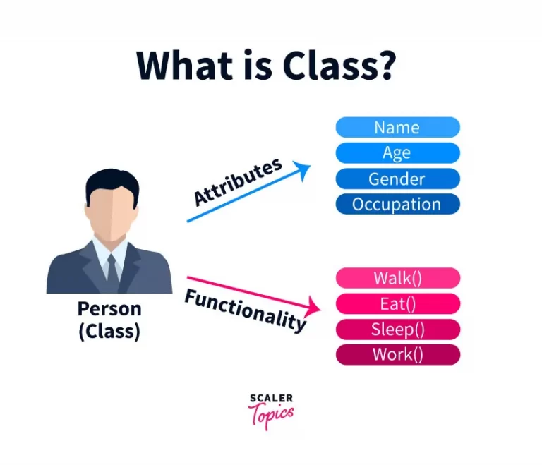
2. What is a Class ?
Class is a user-defined blueprint or prototype from which objects are created.
A class shares common characteristics/ behavior and common properties/ attributes.

Slide 6
2. What is a Class ?
Class is not a real-world entity. It is just a template or blueprint or prototype from which objects are created.
Class does not occupy memory.
Class is a group of variables of different data types and a group of methods.
A Class in Java can contain:
Data member
Method
Constructor
Nested Class
Interface

Slide 7
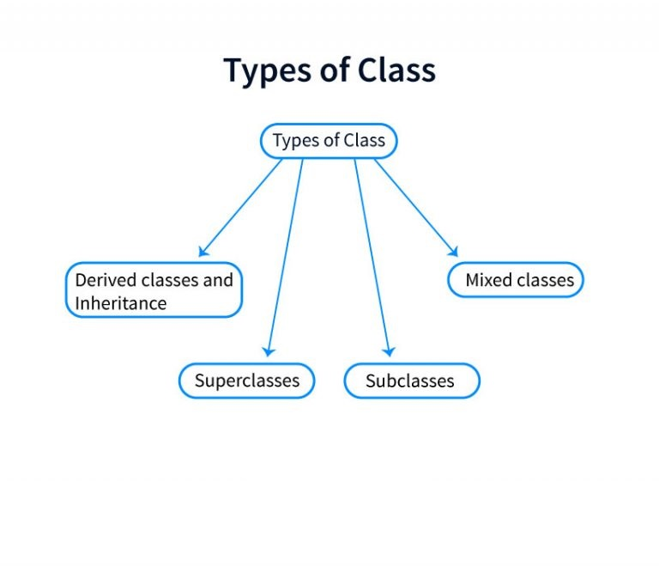
2. What is a Class ?

Slide 8
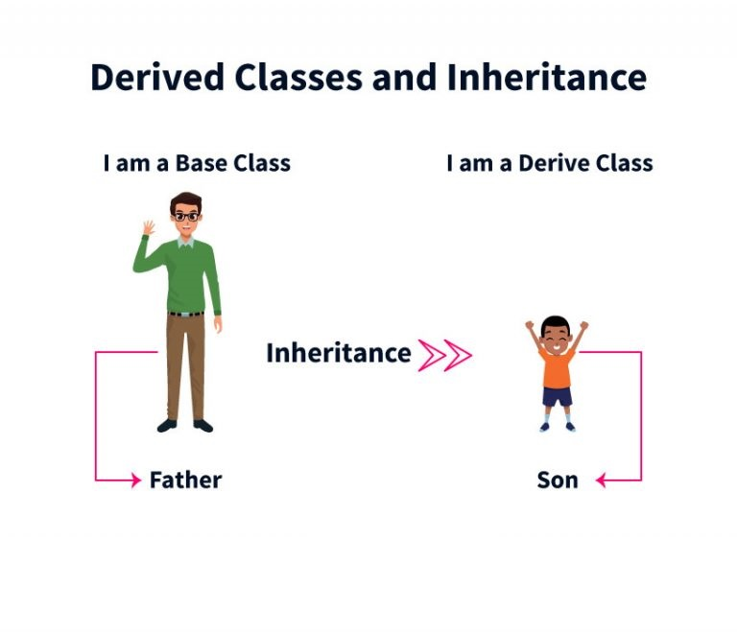
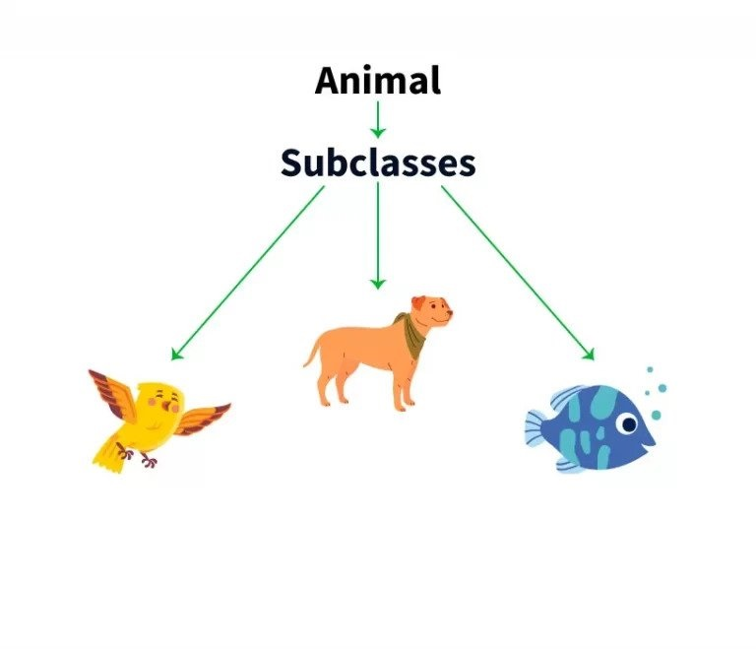
2. What is a Class ?

Slide 9

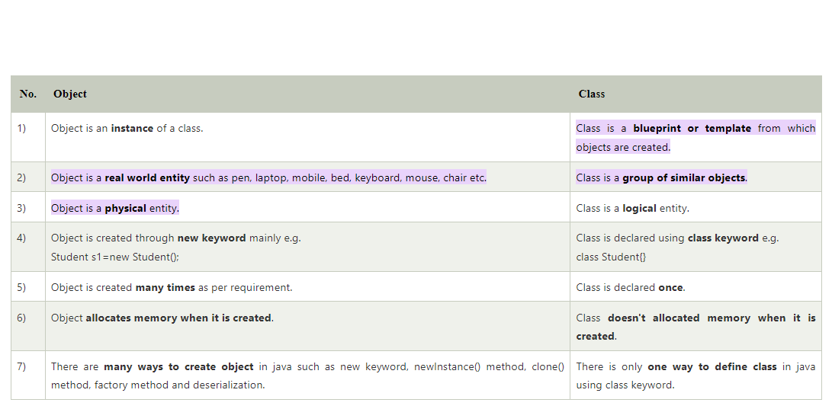
4. Difference between class and object ?

Slide 10
4. Additional data
A variable which is created inside the class but outside the method is known as an instance variable.
Instance variable doesn't get memory at compile time.
It gets memory at runtime when an object or instance is created. That is why it is known as an instance variable.
In Java, a method is like a function which is used to expose the behavior of an object.
Code Reusability
Code Optimization

Slide 11
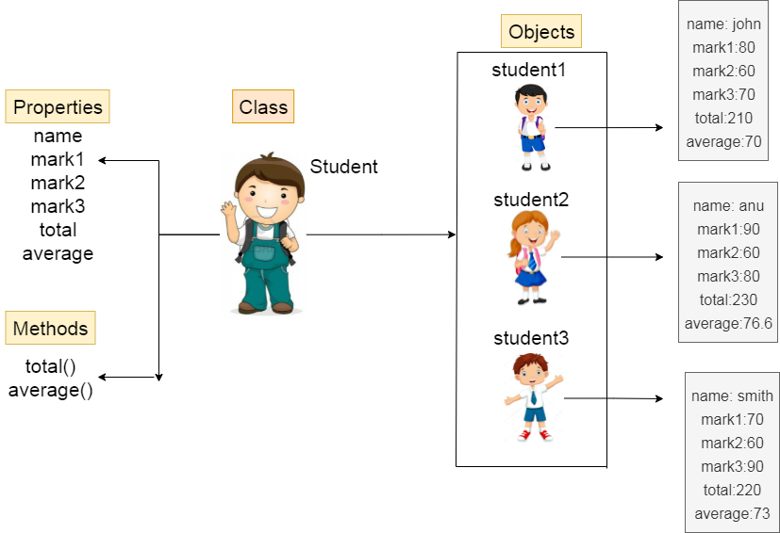
5. Source code

Slide 12
5. Source code
Ways to Create an Object of a Class
1. Using new keyword => Test t = new Test();
2. Using Class.forName(String className) method =>
Test obj = (Test)Class.forName("com.p1.Test").newInstance();
3. Using clone() method => Test t1 = new Test();
Test t2 = (Test)t1.clone();
4. Deserialization => FileInputStream file = new FileInputStream(filename);
ObjectInputStream in = new ObjectInputStream(file);
Object obj = in.readObject();

Slide 13
Reference Resources?
Head First JAVA (book)
Object and class in java in www.javatpoint.com
Classes and Objects in Java in www.geeksforgeeks.org
Difference between object and class in www.javatpoint.com
Difference Between Class and Object in OOPs in www.guru99.com

Slide 14
Thank you!
Presented by Sanjar

